Slide 1
ATHLETA DIRECT MAIL MODEL
OCTOBER 2017
PLATFORM ANALYTICS

Slide 2
BACKGROUND AND OBJECTIVE
Business Objectives :
To identify customers who will respond to a direct mail campaign
Analytical Approach:
Trained 480 XGBoost classification models using four 2016 direct mail campaigns
These four campaigns had 6.4% response
Selected best 50 models out of the 480 models based on in time validation results
Averaged the results of these 50 models

Slide 3
Variables used in modeling :
Discount availed on last 6 months of online sales
No of transactions using PLCB card in last 12 months of online sales
Net sales using PLCB card in last 12 months of retail sales
Net sales using PLCB card in last 6 months of online sales
Net sales amount returned in last 12 months of online sales
Net margin in last 12 months of online sales
Net margin in last 6 months of retail sales
No of transactions returned in last 12 months of retail transactions
Discount availed in last 12 months of retail sales
No of transactions returned in last 6 months of online transactions
Response rate to direct mails sent in last 12 months
Net sales in last 12 months during a promotion
No of days since last online purchase
No of items bought on sale in last 6 months online
Discount availed during a promotion in last 12 months
No of promotions received in last 12 months
No of items bought on sale in last 12 months of retail purchase
No of divisions shopped from in retail sales
No of items returned in last 6 months of retail sales
No of items purchased on sale in last 6 months of retail purchases
No of divisions shopped from in online sales
No of divisions shopped from
No of days since acquisition
No of transactions returned in last 6 months of online transactions in other brands
Net sales returned in last 12 months of online transactions in other brands
Days since last online purchase in other brands
Net sales amount in last 6 months of online transactions using PLCB card in other brands
No of transactions in last 12 months using PLCB card in other brands
Net sales amount returned in last 12 months of retail transactions in other brands
No of items purchased in last 6 months of online purchases in other brands
No of items returned in last 6 months of retail transactions in other brands
Days since last retail purchase

Slide 4
Variable Importance in the model (in %)

Slide 5
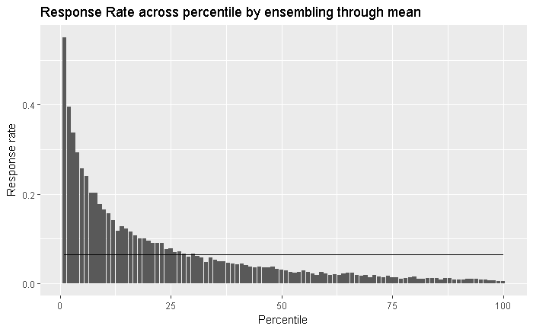
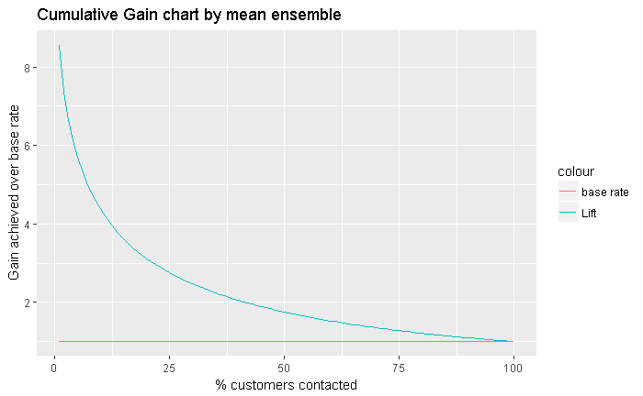
Model outputs on 2016 campaigns

Slide 6
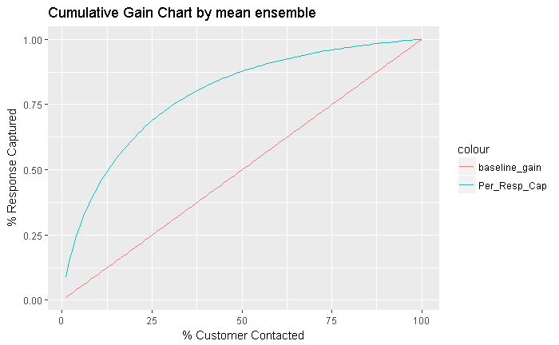
Model outputs on 2016 campaigns
Customers were put in percentiles according to the decreasing order of probability given by the model
Response rate in the upper percentiles was better than the lower percentiles
The initial percentiles have 8 times more response than base response of 6.4%
The initial 50 percentile of customers consist of about 87-88% of responders

Slide 7
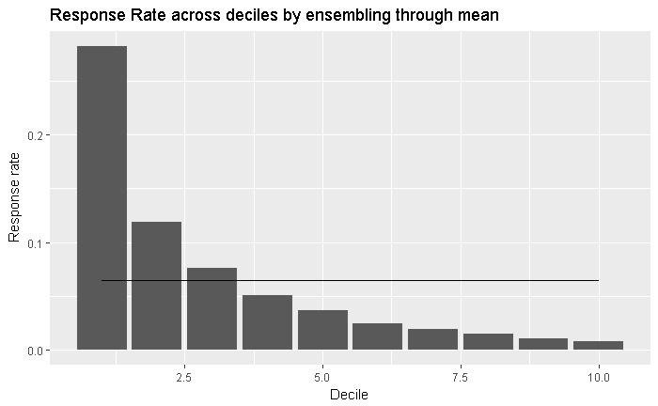
At Decile Level
Model outputs on 2016 campaigns
Decile | Num of Customers | Num of Responders | Cumulative Responders | Response rate | % Response captured | Cumulative response rate | Lift
1 | 41103 | 11611 | 11611 | 28.25% | 43.86% | 28.25% | 4.386581974
2 | 41103 | 4880 | 16491 | 11.87% | 62.30% | 20.06% | 3.115111676
3 | 41103 | 3130 | 19621 | 7.62% | 74.13% | 15.91% | 2.470907614
4 | 41104 | 2097 | 21718 | 5.10% | 82.05% | 13.21% | 2.051190026
5 | 41103 | 1520 | 23238 | 3.70% | 87.79% | 11.31% | 1.755841735
6 | 41103 | 1022 | 24260 | 2.49% | 91.65% | 9.84% | 1.527552589
7 | 41104 | 812 | 25072 | 1.98% | 94.72% | 8.71% | 1.353122133
8 | 41103 | 603 | 25675 | 1.47% | 97.00% | 7.81% | 1.212486997
9 | 41103 | 450 | 26125 | 1.09% | 98.70% | 7.06% | 1.096655988
10 | 41104 | 345 | 26470 | 0.84% | 100.00% | 6.44% | 1

Slide 8
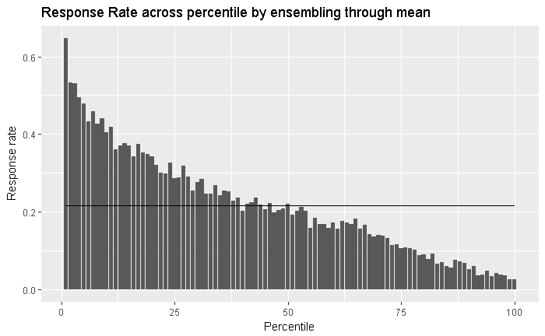
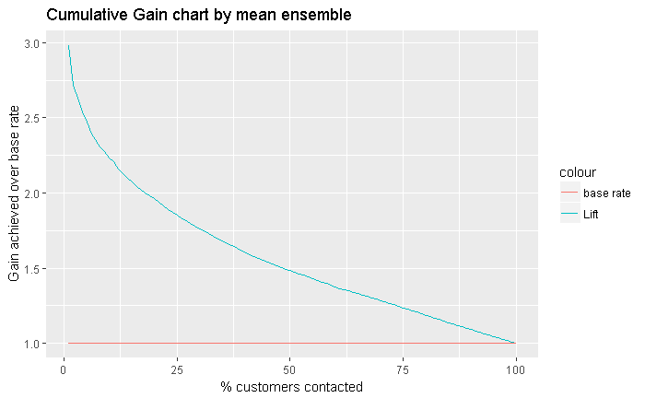
Model outputs on 2017 campaign

Slide 9
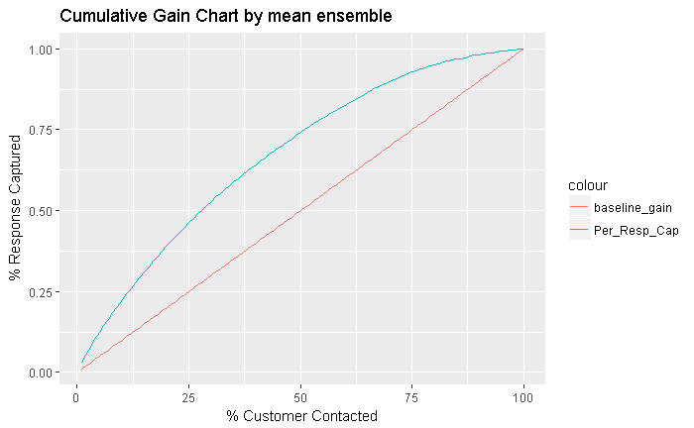
Model outputs on 2017 campaign
The initial percentiles have 3 times more response than base response of 21%
The initial 50 percentile of customers consist of about 75% of responders

Slide 10
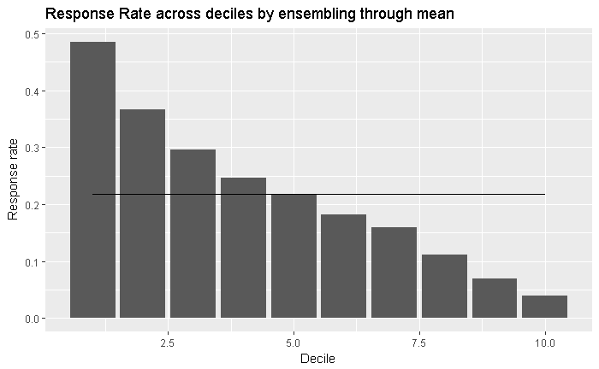
Model outputs on 2017 campaign
Decile | Num of Customers | Num of Responders | Cumulative Responders | Response rate | % Response captured | Cumulative response rate | Lift
1 | 7721 | 3748 | 3748 | 0.485429349 | 0.223481 | 0.485429349 | 2.2351
2 | 7722 | 2827 | 6575 | 0.366096866 | 0.3920458 | 0.425731676 | 1.960229
3 | 7722 | 2289 | 8864 | 0.296425796 | 0.5285314 | 0.382629716 | 1.761771
4 | 7722 | 1905 | 10769 | 0.246697747 | 0.6421203 | 0.348646724 | 1.605301
5 | 7722 | 1670 | 12439 | 0.216265216 | 0.741697 | 0.322170422 | 1.483394
6 | 7722 | 1408 | 13847 | 0.182336182 | 0.8256514 | 0.298864716 | 1.376086
7 | 7722 | 1235 | 15082 | 0.15993266 | 0.8992904 | 0.279017279 | 1.284701
8 | 7722 | 854 | 15936 | 0.110593111 | 0.9502117 | 0.257964258 | 1.187765
9 | 7722 | 535 | 16471 | 0.069282569 | 0.982112 | 0.236999626 | 1.091236
10 | 7722 | 300 | 16771 | 0.038850039 | 1 | 0.217184667 | 1

Slide 11
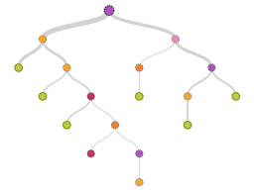
Appendix
XGBoost is a tree based algorithm
Different trees were trained by tuning different parameters like sample size, eta, no. of rounds and depth of a tree
Best 50 models out of the 480 trained models were chosen on the basis of Area under ROC curve

Slide 12
Thank you

